Slide 1
Central Problems of an Economy

Slide 2
A number of activities happen around us in our daily life, such as activities performed in shops, offices, hospitals, etc. The collection of these organisations and institutions is known as an economy. These units allow human beings to earn and simultaneously help them to produce goods and services for their use. An economy provides living to the people by making the use of available resources for the production of goods and services according to human wants. To do so, an economy undertakes three economic activities; viz., Production, Distribution, and Disposition.

Slide 3
The three basic economic activities performed in an economy are Production, Distribution, and Disposition. While performing these activities, every economy has to face the issue of scarcity of resources, as the resources available are limited and human wants are unlimited. Therefore, it becomes essential to decide on how to allocate the available scarce resources, leading to the three Central Problems of an Economy:
What to Produce
How to Produce
For Whom to Produce
These three basic problems of an economy are known as the central problems. Every other economic problem revolves around the three central problems.

Slide 4
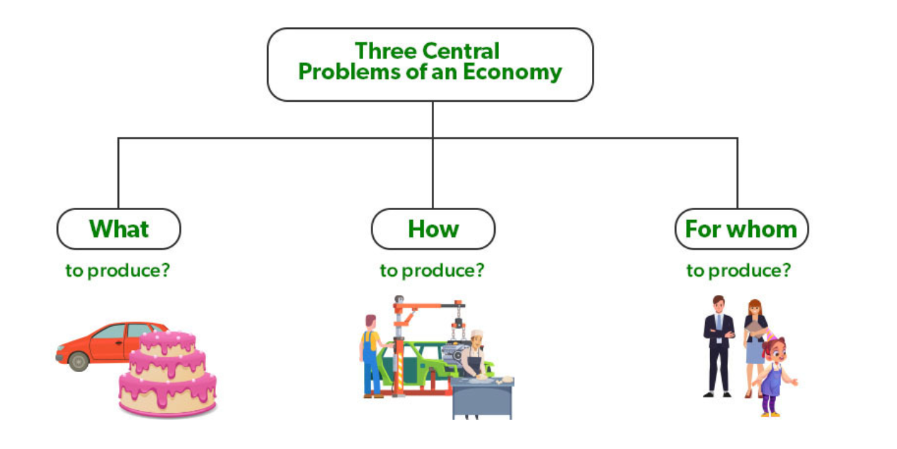

Slide 5
1. What to Produce and How much?
With limited resources, an economy cannot produce all goods and services. It has to choose among the different goods and services. Therefore, the first central problem of an economy includes selecting goods and services to produce and the number of units or quantity of each commodity to be produced. For example, a farmer has to choose between different crops as to which he should grow on one piece of land. He can decide to grow one crop on the whole land or grow crops of different proportions.
There are two aspects of the problem of What to Produce. These aspects are as follows:
What possible commodities to produce: The first aspect of the problem of 'What to produce' is deciding which commodities to be produced in an economy. It means that an economy has to choose between different consumer goods (clothes, wheat, etc.) and capital goods (machinery, etc.) to produce. Similarly, it has to choose between different war goods (tanks, guns, bullets, etc.) and civil goods (milk, bread, butter, etc.).
How much to produce: Once the economy has decided the commodity to be produced, it has to decide the quantity of each selected commodity to be produced. Simply put, it means deciding the quantity of each selected consumer good, capital good, civil good, and war good to be produced in an economy.
As the two aspects of the first central problem of an economy are What possible commodities to produce and How much to produce, it is also known as What to Produce and in What Quantity. This problem can be solved by allocating the resources of an economy in a way that provides maximum aggregate satisfaction to society.

Slide 6
2. How to produce?
After deciding what to produce, another central problem of how to manufacture the goods and services arises. It involves selecting a technique of production from among different techniques. Usually, there are two techniques of production, Labour Intensive Techniques (LIT) and Capital Intensive Techniques (CIT). The former technique involves more use of labour, and the latter involves more use of machines. An organization can decide the technique based on different factors like the nature of the product, size of the market, size of the location, budget, etc. For example, a poor farmer can adopt labour-intensive techniques as they are cheap. However, a rich farmer can adopt capital-intensive techniques as he can afford to purchase machines.
While selecting the technique of production, an economy aims at raising the standard of living of people and providing employment to everyone. For Instance, labour Intensive Techniques are preferred in countries like India as labour is found in abundance in these countries. However, Capital Intensive Techniques are preferred in countries like the USA as capital is found in abundance in these countries.
The problem of How to Produce can be solved by combining the factors of production of an economy in a way that it can produce maximum output at minimum cost by using the least possible scarce resources.

Slide 7
3. For whom to produce?
The last central problem of an economy after deciding what and how to produce is For Whom to Produce. As an economy cannot satisfy the needs and wants of every individual of the society, it has to make a decision for who to produce a commodity and service. Simply put, it involves deciding who should get how much of the goods and services, i.e., how much production should be done for the poor and how much for the rich. For example, an organization can decide to produce necessity goods for the poor section of society. However, another firm can decide to produce luxury goods for the rich section of society.
As every economy has scarce resources and cannot fulfil every want of people, it faces the problem of choice between different sections of society. Hence, an economy produces goods for those people who can pay for them which depends on their income level. It means that the problem of 'for whom to produce' is concerned with the income distribution among the different factors of production (like capital, land, labour, and enterprise) which contribute to the production process.
The problem of For Whom to Produce can be classified under two main heads Personal Distribution and Functional Distribution.
Personal Distribution: It tells us about how an economy distributes its national income among different groups of people.
Functional Distribution: Functional Distribution means deciding the share of different factors of production in a country's total national product.
The problem of For Whom to Produce can be solved by making sure that the urgent wants of each productive factor of the society are fulfilled to the maximum possible extent.

